Slide 1


NEXT GEN EMPLOYABILITY PROGRAM
CREATING A FUTURE-READY WORKFORCE
College Name :
Radha Govind Engineering College ( Affiliated to Dr. A.P.J. Abdul Kalam Technical University (AKTU), Lucknow, Uttar Pradesh)
Department :
B.Tech (INFORMATION TECHNOLOGY)
Student Name :
Deepak Khulve
Student ID :
STU62635233eb6f91650676275

Slide 2
CAPSTONE PROJECT SHOWCASE
P5-Ecommerce MERN Project
Abstract | Problem Statement | Project Overview | Proposed Solution | Technology Used | Modelling & Results | Conclusion | Q&A

Slide 3
Abstract
This project is a full-stack e-commerce application built using the MERN (MongoDB, Express.js, React, Node.js) stack. It provides a seamless and efficient online shopping experience for users, integrating features such as user authentication, product management, order processing, and secure payment gateways.
The backend, powered by Node.js and Express.js, manages user authentication, product catalogs, order history, and real-time database operations using MongoDB. The frontend, developed with React, offers an interactive and responsive user interface for browsing products, managing carts, and completing purchases.
Key features include:
User Authentication: Secure login and registration using JWT.
Product Management: CRUD operations for products and categories.
Shopping Cart & Checkout: A dynamic cart system with order management.
Payment Integration: Secure transactions using Stripe or PayPal.
Admin Dashboard: Role-based access for managing users, orders, and inventory.
Scalability & Performance: Optimized backend and frontend for smooth performance.
This project demonstrates the power of the MERN stack in building a scalable, feature-rich e-commerce platform, offering both users and administrators a seamless digital shopping experience.

Slide 4


Problem Statement
In today's digital era, traditional shopping methods face numerous challenges, including limited accessibility, time constraints, and inefficiencies in product management. Many small and medium-sized businesses struggle to establish a strong online presence due to technical and financial barriers. Existing e-commerce platforms often lack customization, scalability, and user-friendly interfaces, making it difficult for businesses to provide a seamless shopping experience.
Additionally, security concerns, inefficient order management, and the absence of real-time inventory tracking lead to poor customer satisfaction. Consumers demand a fast, reliable, and secure shopping experience with easy navigation, secure payment options, and efficient order tracking.

Slide 5

Project Overview
Introduction
This project is a full-stack e-commerce web application built using the MERN stack (MongoDB, Express.js, React, and Node.js). The platform provides a seamless and scalable solution for businesses to sell products online while offering a smooth and interactive shopping experience for customers.
Objectives
Develop a user-friendly, responsive e-commerce platform.
Provide a secure and efficient shopping experience.
Enable easy product management for sellers and admins.
Implement secure authentication and role-based access control.
Ensure smooth order processing and real-time inventory management.

Slide 6
Key Features
🔹 User Features
✔️ User authentication (JWT-based login & signup). ✔️ Product browsing, searching, and filtering. ✔️ Shopping cart and checkout system. ✔️ Secure online payments (Stripe/PayPal). ✔️ Order tracking and purchase history.
🔹 Admin Features
✔️ Dashboard to manage users, products, and orders. ✔️ Inventory management and stock updates. ✔️ Order processing and status management. ✔️ Role-based access control (Admin, Seller, Customer).

Slide 7
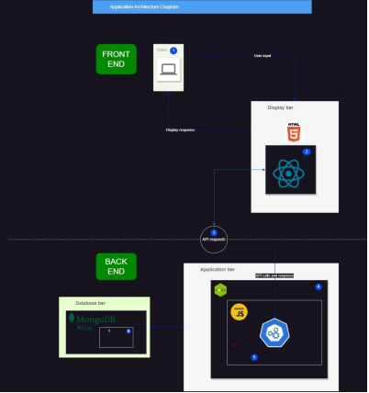
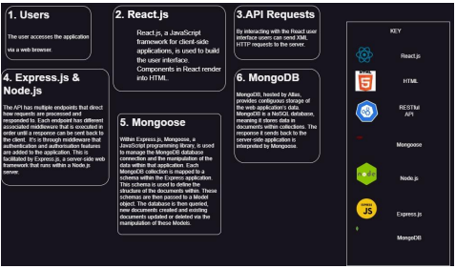
Application Architecture

Slide 8
Proposed Solution
To address these challenges, this project aims to develop a scalable, secure, and user-friendly e-commerce platform using the MERN stack (MongoDB, Express.js, React, Node.js). The system will offer:
User Authentication: Secure login and registration using JWT authentication.
Product Management: A flexible and easy-to-use product catalog system.
Shopping Cart & Checkout: A dynamic cart system with real-time updates.
Secure Payment Integration: Seamless transactions using Stripe or PayPal.
Admin Dashboard: Role-based access for managing orders, users, and inventory.
Real-time Order Tracking: Updates for users on order status and delivery.
By leveraging modern web technologies, this e-commerce platform will provide businesses with an efficient online storefront while ensuring a fast, secure, and convenient shopping experience for customers.

Slide 9
Technology used
Frontend: React.js (with Redux for state management).
Backend: Node.js with Express.js
Database: MongoDB (NoSQL database for flexible data storage).

Slide 10
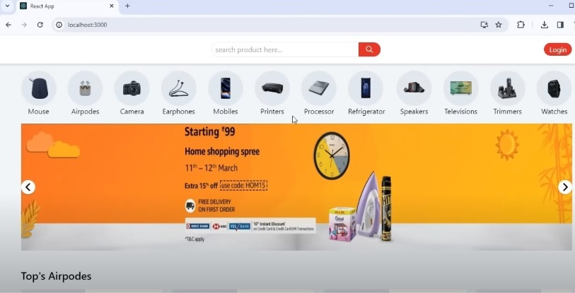
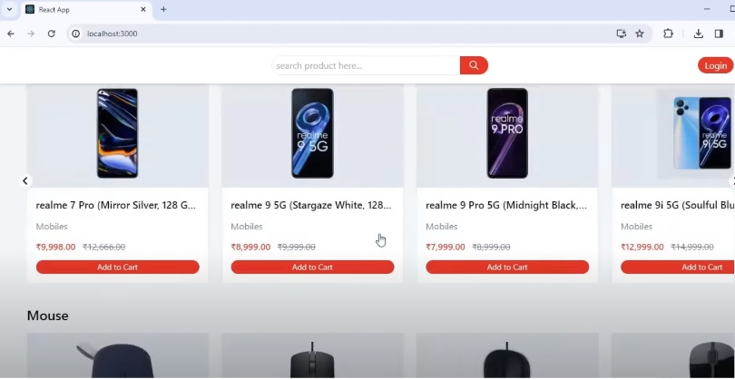
Modelling & Result

Slide 11
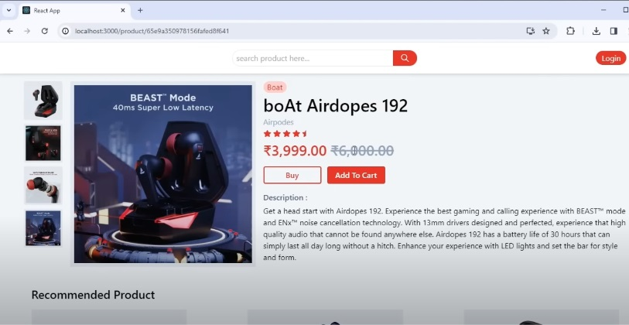
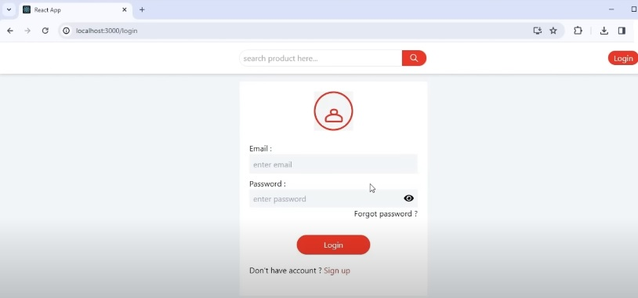
Modelling & Result

Slide 12
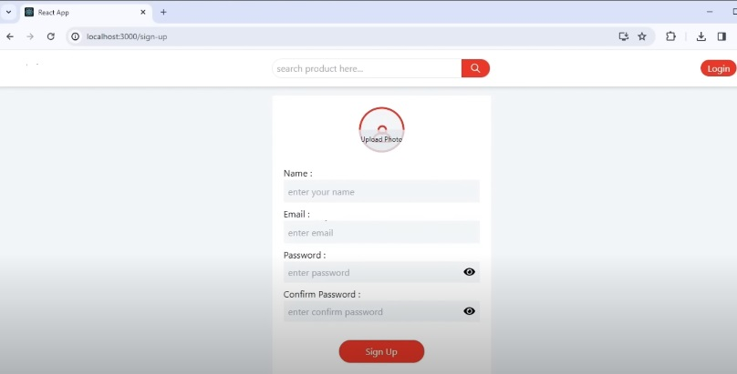
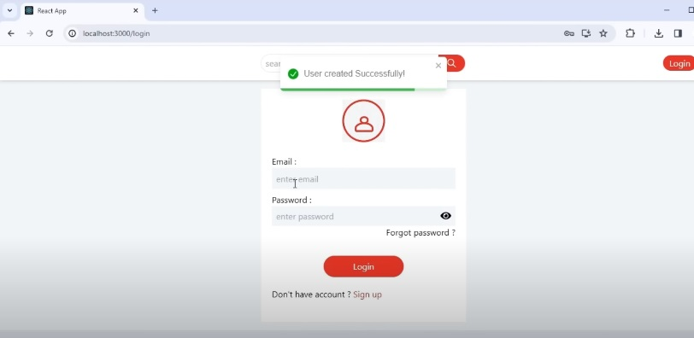
Modelling & Result

Slide 13
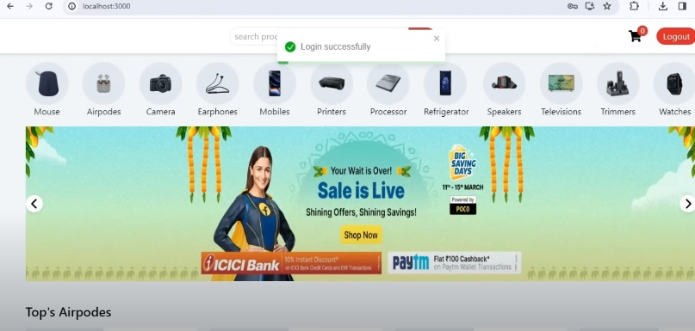
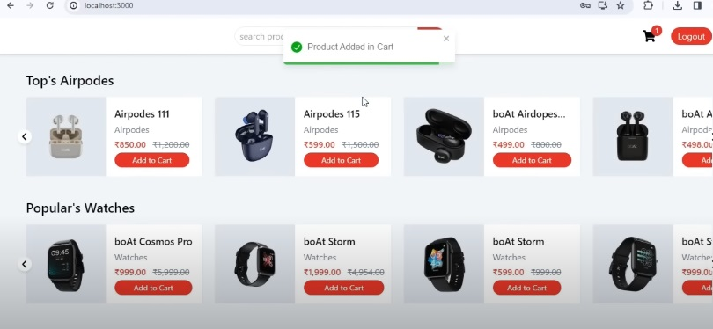
Modelling & Result

Slide 14
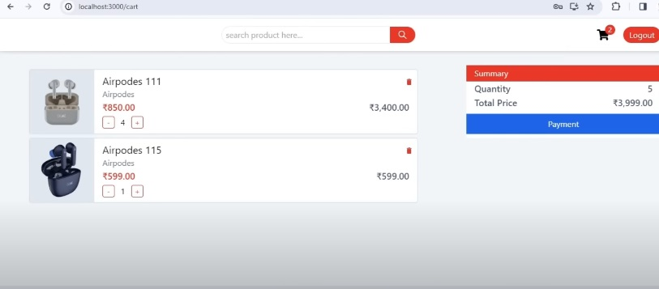
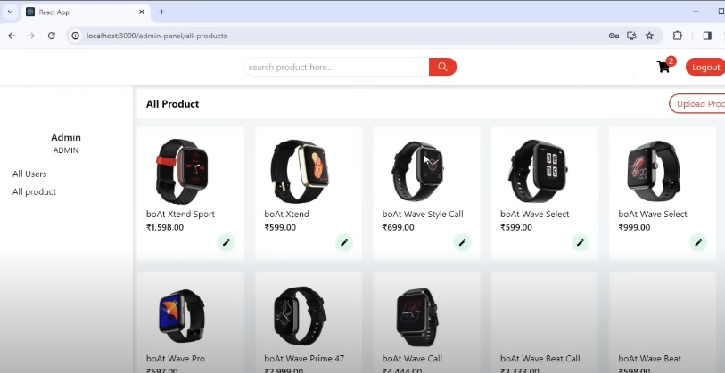
Modelling & Result

Slide 15
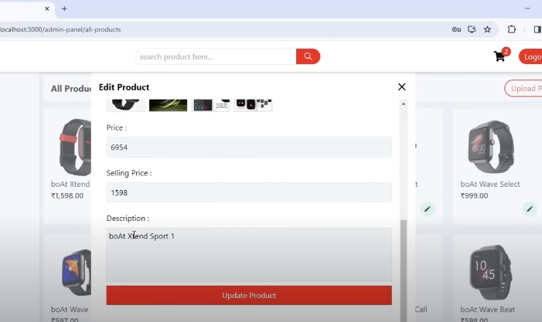
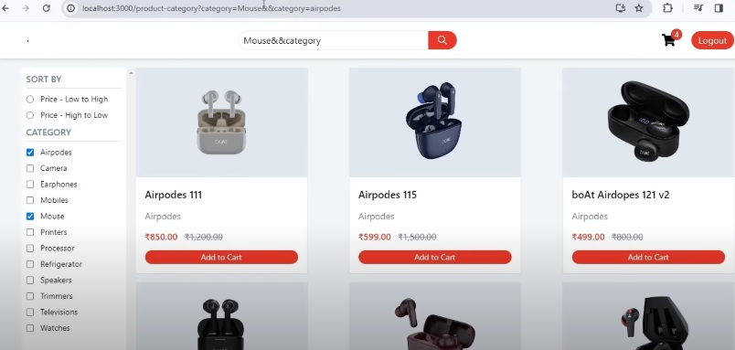
Modelling & Result

Slide 16

Conclusion
The project aims to deliver a scalable, high-performance e-commerce platform that supports multiple users, ensures secure transactions, and provides a seamless user experience. It will benefit small to medium-sized businesses looking for an affordable and customizable online store solution.

Slide 17


Notes:
Thank You !!

